Slide 1

Balanced BSTs
"The voyage of discovery is not in seeking new landscapes but in having new eyes. "
- Marcel Proust
CLRS, pages 333, 337

Slide 2
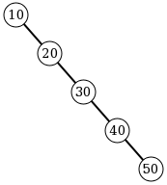
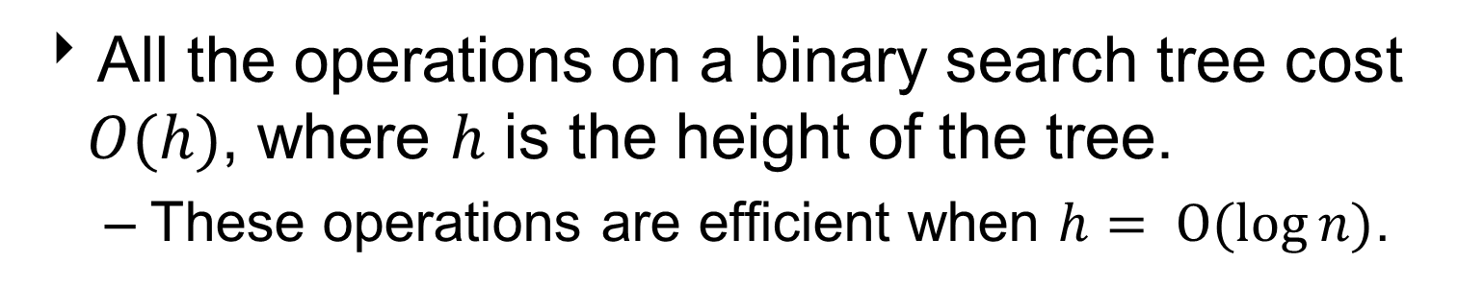
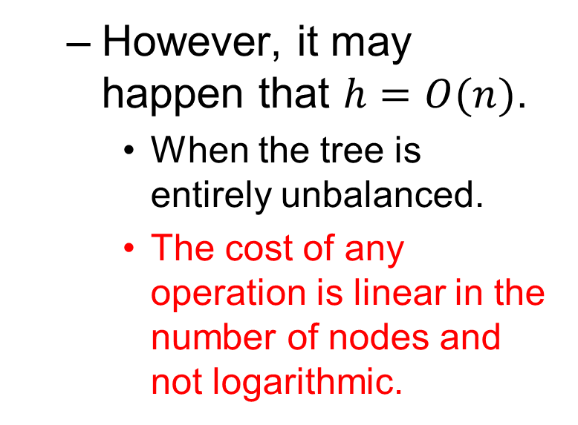
Binary Search Trees
All the operations on a binary search tree cost $O(h)$, where $h$ is the height of the tree.
These operations are efficient when $h= O(log{n)}$.
However, it may happen that $h=O(n)$.
When the tree is entirely unbalanced.
The cost of any operation is linear in the number of nodes and not logarithmic.
Solution: Keep the tree balance to ensure operations always cost O(log n)!

Slide 3
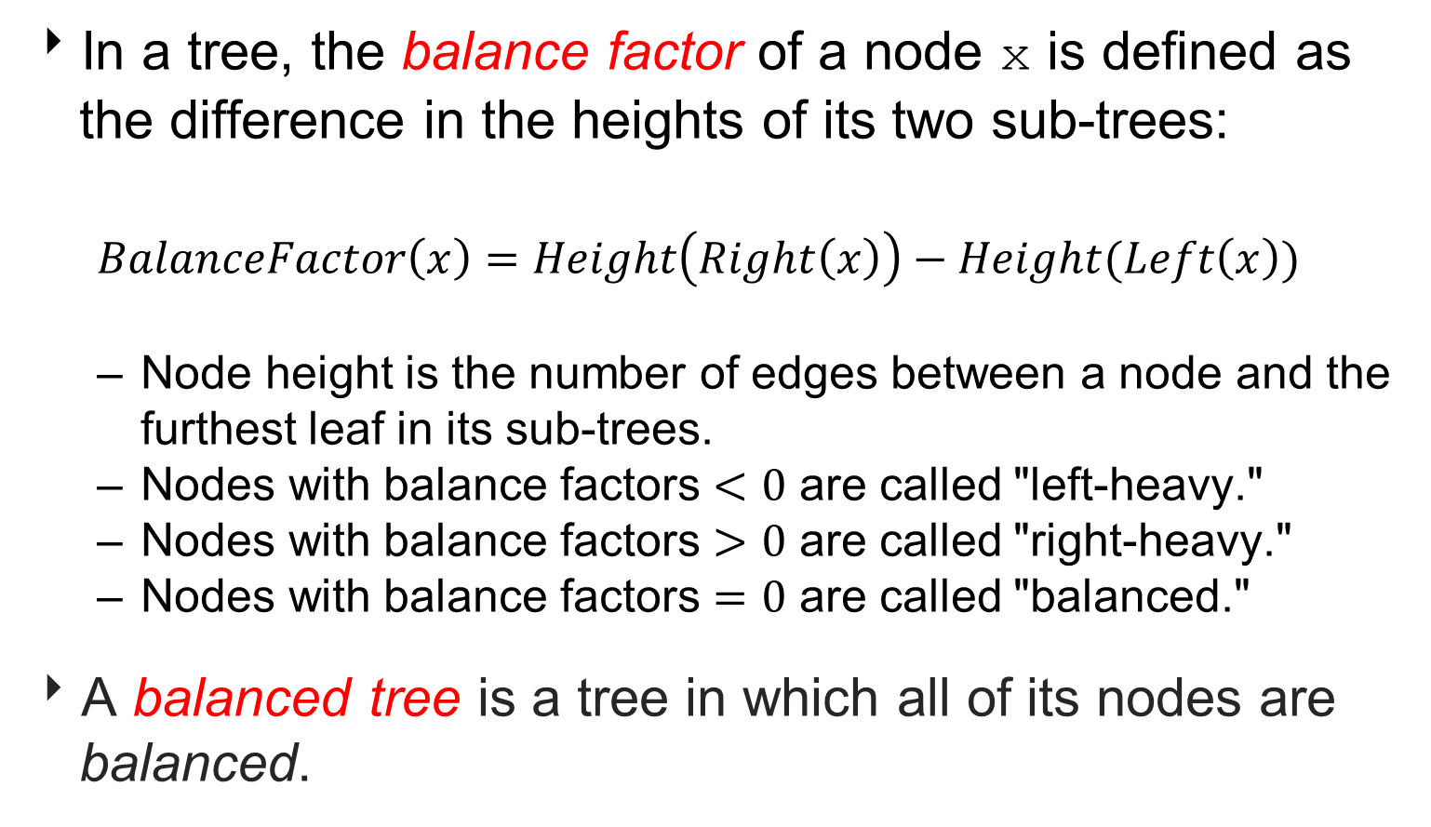
Measuring Tree Balance
In a tree, the balance factor of a node x is defined as the difference in the heights of its two sub-trees:
$$BalanceFactor\left(x\right)=Height\left(Right\left(x\right)\right)−Height(Left\left(x\right))$$
Node height is the number of edges between a node and the furthest leaf in its sub-trees.
Nodes with balance factors $<0$ are called "left-heavy."
Nodes with balance factors $>0$ are called "right-heavy."
Nodes with balance factors $=0$ are called "balanced."
A balanced tree is a tree in which all of its nodes are balanced.

Slide 4
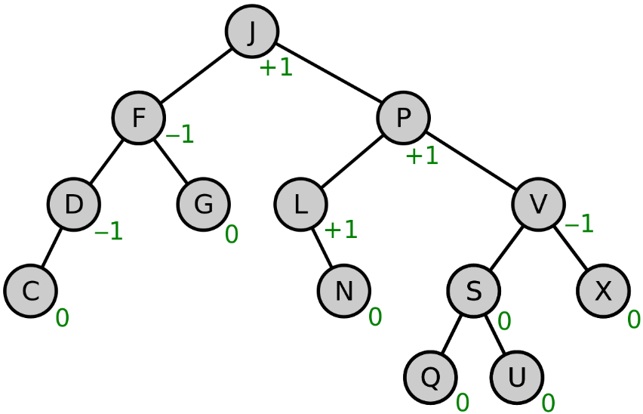
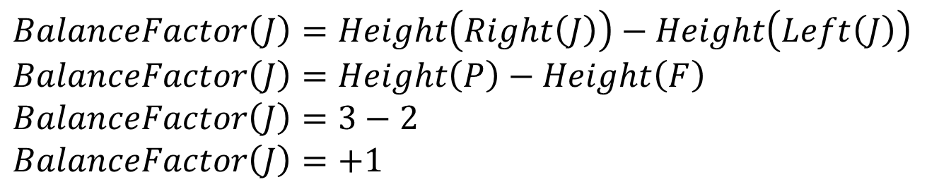
Calculating Balance Factor
For instance, the balance factor of J is:
$$BalanceFactor\left(J\right)=Height\left(Right\left(J\right)\right)−Height\left(Left\left(J\right)\right)$$
$$BalanceFactor\left(J\right)=Height\left(P\right)−Height\left(F\right)$$
$$BalanceFactor\left(J\right)=3−2$$
$$BalanceFactor\left(J\right)=+1$$
h = 2
h = 3

Slide 5
Tree Balancing Choices
Don’t balance.
May end up with some very deep nodes.
Strict balance.
The tree must always be balanced perfectly.
Expensive.
Must ensure tree complete after every modification.
Good balance.
Allow some imbalance.
Adjust on access.
Self-adjusting.

Slide 6
Balancing Binary Search Trees
Ignoring balance leads to poor performance.
Maintaining perfect balance is too costly.
Many algorithms exist for keeping good balance.
Multi-way Search trees.
B-Trees
Self-adjusting trees.
Splay Trees
Height-balanced trees.
AVL Trees (Adelson-Velskii and Landis)

Slide 7
B-Trees
B-Trees are multi-way search trees.
Designed to work well on Direct Access secondary storage devices (magnetic disks).
Better performance on disk I/O operations than other specialized BSTs, like AVL and red-black trees.
B-trees (and variants like B+ and B* trees ) are widely used in database systems.
Notes:
A B+ tree is an N-ary tree with a variable but often large number of children per node. A B+ tree consists of a root, internal nodes and leaves. The root may be either a leaf or a node with two or more children.
A B+ tree can be viewed as a B-tree in which each node contains only keys (not key–value pairs), and to which an additional level is added at the bottom with linked leaves.
The B* tree balances more neighboring internal nodes to keep the internal nodes more densely packed. This variant ensures non-root nodes are at least 2/3 full instead of 1/2. As the most costly part of operation of inserting the node in B-tree is splitting the node, B*-trees are created to postpone splitting operation as long as they can. To maintain this, instead of immediately splitting up a node when it gets full, its keys are shared with a node next to it.

Slide 8
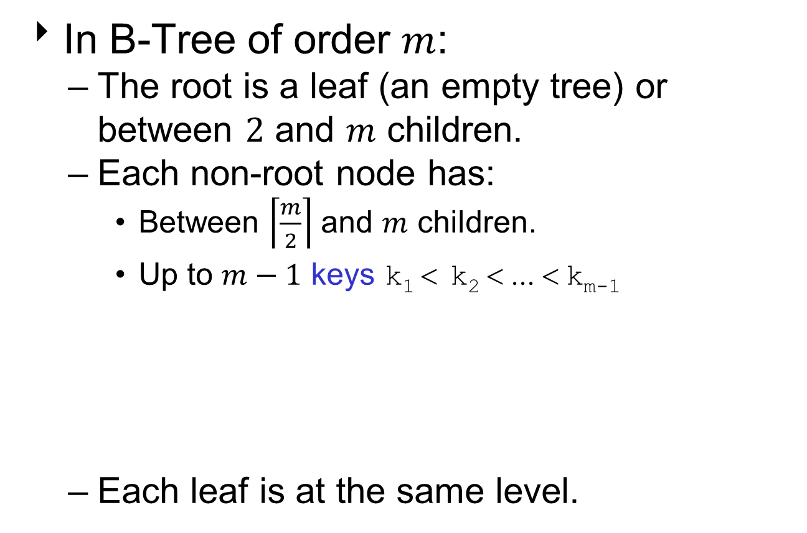
B-Tree Properties
In B-Tree of order $m$:
The root is a leaf (an empty tree) or between $2$ and $m$ children.
Each non-root node has:
Between $\left\lceil \frac{m}{2}\right\rceil$ and $m$ children.
Up to $m−1$ keys k₁ < k₂ < ... < k_{m-1}
Each leaf is at the same level.
k₁
. . .
k_{i-1}
k_{i}
. . .
k_{m-1}

Slide 9
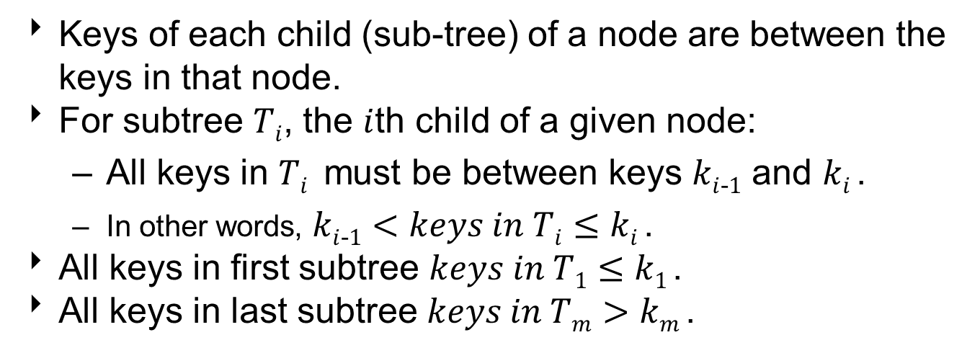
B-Tree Properties
k₁
. . .
k_{i-1}
k_{i}
. . .
k_{m-1}
T
1
. . .
T
i-1
T
i
. . .
T
m
Keys of each child (sub-tree) of a node are between the keys in that node.
For subtree $Ti$, the $i$th child of a given node:
All keys in $Ti$ must be between keys $ki$₋$1$ and $ki$.
In other words, $ki$₋$1$ $<keys in Ti≤$ $ki$.
All keys in first subtree $keys in T1≤$ $k1$.
All keys in last subtree $keys in Tm>$ $km$.

Slide 10
B-Tree Example
B-tree of order 3 has 2 or 3 children per node.
Also, known as a 2-3 tree.
12:-
5: 9
16:-
3: 4
6: 7: 8
10: 11
13: 14
17: 18
Note: If leaf nodes are connected as a linked list, a B-tree is called a B+ tree.
Allows sorted list to be accessed easily.

Slide 11
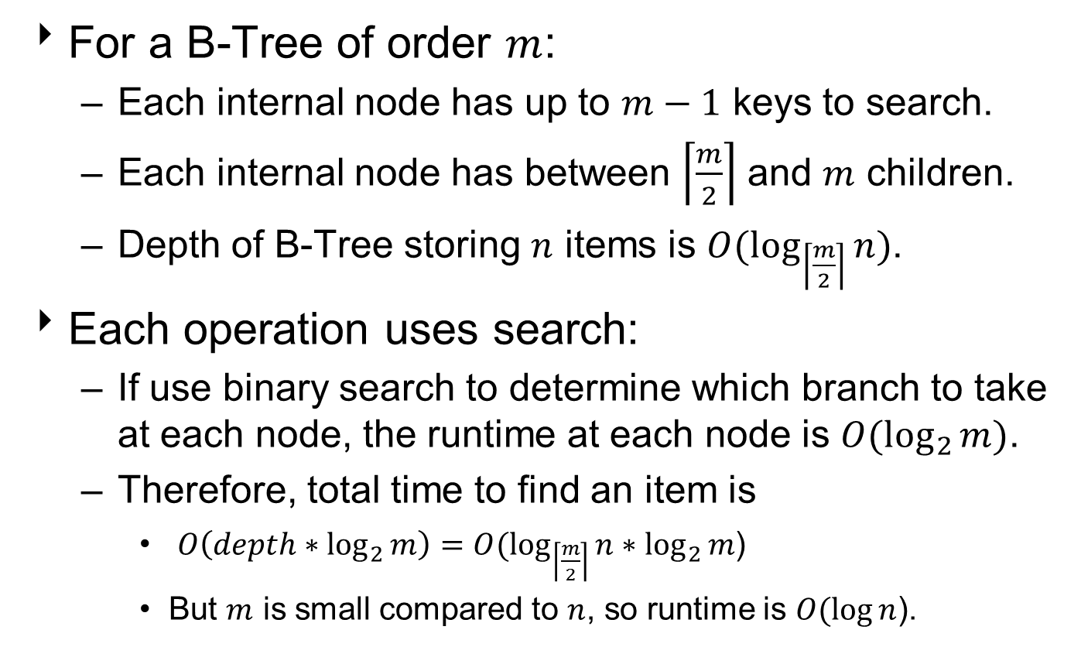
Runtime Analysis of B-Trees
For a B-Tree of order $m$:
Each internal node has up to $m−1$ keys to search.
Each internal node has between $\left\lceil \frac{m}{2}\right\rceil$ and $m$ children.
Depth of B-Tree storing $n$ items is $O(\log_{\left\lceil \frac{m}{2}\right\rceil }{n})$.
Each operation uses search:
If use binary search to determine which branch to take at each node, the runtime at each node is $O(\log_{2}{m)}$.
Therefore, total time to find an item is
$O\left(depth∗\log_{2}{m}\right)=O(\log_{\left\lceil \frac{m}{2}\right\rceil }{n}∗\log_{2}{m}$)
But $m$ is small compared to $n$, so runtime is $O(\log{n}$).

Slide 12
Self-Adjusting Trees
Ordinary binary search trees have no balance conditions.
What you get from insertion order is it.
Balanced trees like AVL trees enforce a balance condition when nodes change.
Tree is always balanced after an insert or delete.
Self-adjusting trees get reorganized over time as nodes are accessed.
Tree adjusts after insert, delete, or search operations.

Slide 13
Splay Trees
Self-adjusting binary search tree.
Splay trees are tree structures that:
Are not perfectly balanced all the time.
Data most recently accessed is near the root.
The procedure:
After node X is accessed, perform “splay” operations to bring X to the root of the tree.
Leaves the tree more balanced as a whole.
Most recently accessed nodes are at the top of the tree.

Slide 14
Splay Tree Terminology
When node X is accessed, which splay operation applied depends on the orientation of X and its parent P and grandparent G, if it exists.
There are two possible categories of orientations:
X’s parent P is root and has no grandparent.
X has a parent P and a grandparent G.

Slide 15
Category I: P is Root
Let X be a non-root node with exactly 1 ancestor.
P is its parent node.
X has no grandparent node.
P
P
X
X

Slide 16
L / R Orientations
L-Orientation:
X is in the left sub-tree of its parent.
R
P
L
9
X
P
R-Orientation:
X is in the right sub-tree of its parent.
X
1

Slide 17
Category II: X has Grandparent
Let X be a non-root node with ≥ 2 ancestors.
P is its parent node.
G is its grandparent node.
G
G
G
G
P
P
P
P
X
X
X
X

Slide 18
LL / RR Orientations
LL-Orientation:
X is in the left sub-tree of its parent and its parent is in the left sub-tree of its grandparent.
5
G
RR
7
P
5
9
X
G
LL
RR-Orientation:
X is in the right sub-tree of its parent and its parent is in the right sub-tree of its grandparent.
P
2
X
1

Slide 19
RL / LR Orientations
4
LR-Orientation:
X is in the right sub-tree of its parent and its parent is in the left sub-tree of its grandparent.
G
RL
P
1
6
4
X
RL-Orientation:
X is in the left sub-tree of its parent and its parent is in the right sub-tree of its grandparent.
G
LR
P
9
6
X

Slide 20
Splaying Operations
When node X is accessed, apply one of six rotation operations, depending on orientation:
Single Rotations (Parent is root, no grandparent)
Zig from Left (L-Orientation).
Zig from Right (R-Orientation).
Double Rotations (X has parent and grandparent)
Zig-Zig from Left (LL-Orientation).
Zig-Zig from Right (RR-Orientation).
Zig-Zag from Left (LR-Orientation).
Zig-Zag from Right (RL-Orientation).

Slide 21
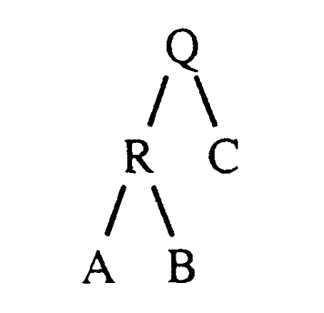
Zig from Left
Assume node R is accessed, and it’s the left child of its parent Q, which is root.
This is an L-Orientation.

Slide 22
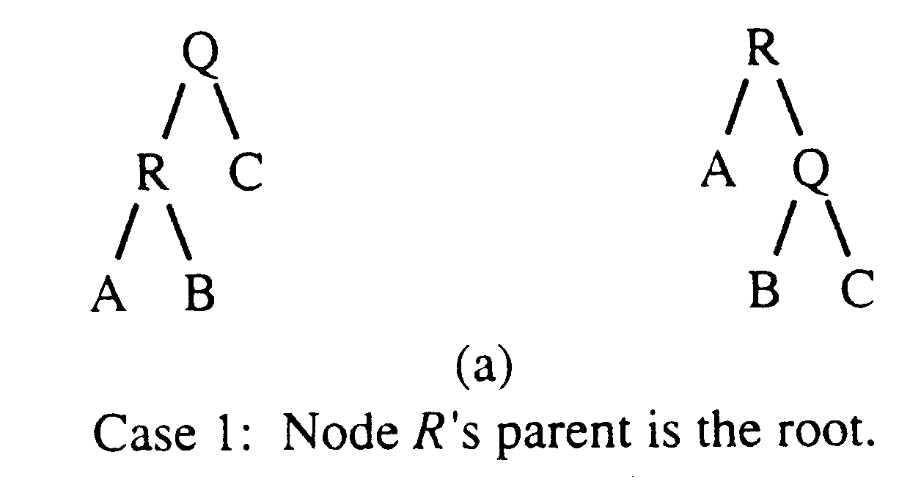
Zig from Left
Apply “Zig from Left” operation.
A single rotation to right.
Elevate R to the root, move Q to its right child.
If R has a right child, move it to Q’s left child.

Slide 23
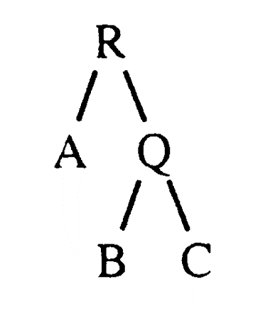
Zig from Right
Assume node Q is accessed, and it’s the right child of its parent R, which is root.
This is an R-Orientation.

Slide 24
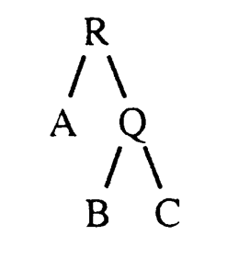
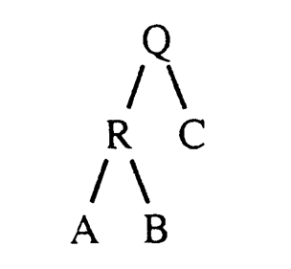
Zig from Right
Apply “Zig from Right” operation.
A single rotation to the right.
Elevate R to the root, move Q to its right child.
If R has a right child, move it to Q’s left child.

Slide 25
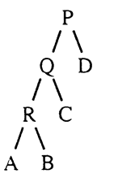
Zig-Zig from Left
Assume node R is accessed, and it’s the left child of its parent Q, which has a parent P.
This is an LL-Orientation.

Slide 26
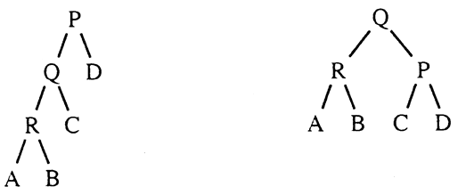
Zig-Zig from Left
Apply “Zig-Zig from Left” operation.
Two rotations to the right.
Each a “Zig from Left” operation.
First “Zig from Left” at Q’s position.
Elevate Q to the P’s position, move P to its right child.
If Q has a right child, move it to P’s left child.

Slide 27
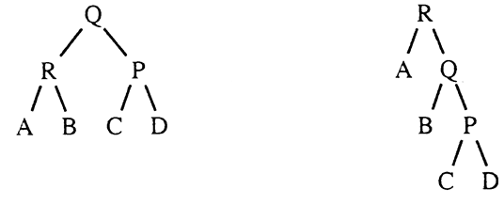
Zig-Zig from Left
Apply another “Zig from Left” operation.
Next rotation at R’s position.
Elevate R to the Q’s position, move Q to its right child.
If R has a right child, move it to Q’s left child.

Slide 28
Zig-Zig from Right
Assume node P is accessed, and it’s the right child of its parent Q, which has a parent R.
This is an RR-Orientation.

Slide 29
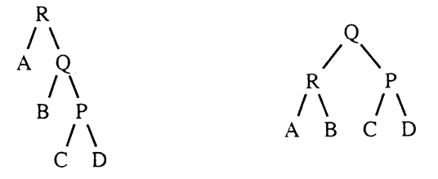
Zig-Zig from Right
Apply “Zig-Zig from Right” operation.
Two rotations to the left.
Each a “Zig from Right” operation.
First “Zig from Right” at Q’s position.
Elevate Q to the R’s position, move R to its left child.
If Q has a left child, move it to R’s right child.

Slide 30
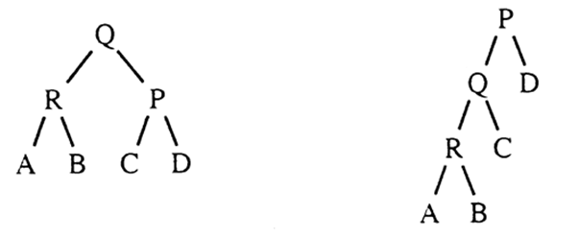
Zig-Zig from Right
Apply another “Zig from Right” operation.
Next rotation at P’s position.
Elevate P to the Q’s position, move Q to its left child.
If P has a left child, move it to Q’s right child.

Slide 31
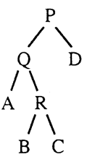
Zig-Zag from Left
Assume node R is accessed, and it’s the right child of its parent Q, and Q is the left child of its parent P.
This is an LR-Orientation.

Slide 32
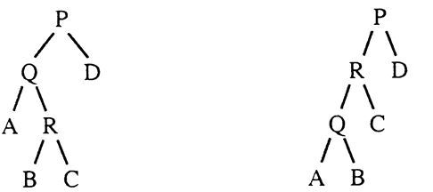
Zig-Zag from Left
Apply “Zig-Zag from Left” operation.
Two rotations: one to left, then one to right.
Begins with “Zig from Right” operation.
Ends with “Zig from Left” operation.
First “Zig from Right” at R’s position.
Elevate R to the Q’s position, move Q to its left child.
If R has a left child, move it to Q’s right child.

Slide 33
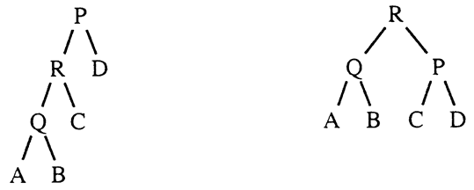
Zig-Zag from Left
Now apply “Zig from Left” operation.
Next rotation also at R’s position.
Elevate R to the P’s position, move P to its right child.
If R has a right child, move it to P’s left child.

Slide 34
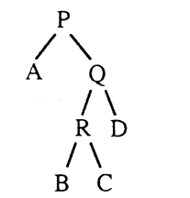
Zig-Zag from Right
Assume node R is accessed, and it’s the left child of its parent Q, and Q is the right child of its parent P.
This is an RL-Orientation.

Slide 35
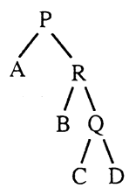
Zig-Zag from Right
Apply “Zig-Zag from Right” operation.
Two rotations: one to right, then one to left.
Begins with “Zig from Left” operation.
Ends with “Zig from Right” operation.
First “Zig from Left” at R’s position.
Elevate R to the Q’s position, move Q to its right child.
If R has a right child, move it to Q’s left child.

Slide 36
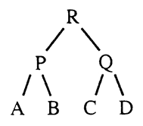
Zig-Zag from Right
Now apply “Zig from Right” operation.
Next rotation also at R’s position.
Elevate R to the P’s position, move P to its left child.
If R has a left child, move it to P’s right child.

Slide 37
Splay Tree Operations
Search for k
Splay node x containing k to root.
Insert for k
Insert new node x with key k like other BSTs, then splay x to root.
Delete for k
Splay x containing k to root and remove it.
Two trees remain, its left and right subtrees.
Splay the node containing maximum key in the left subtree to a new root (i.e. x’s predecessor).
Attach the right subtree to that new root.

Slide 38
Search Operation
When search for key k, if k is found at node x, we splay x to root.
If not successful, the last node accessed prior to reaching null is splayed to the root.

Slide 39
Search Example I
1
1
2
2
Zig-Zig from Right
3
3
Search(6)
4
6
5
5
6
4

Slide 40
Search Example I
1
1
2
6
Zig-Zig from Right
3
3
6
2
5
5
4
4

Slide 41
Search Example I
1
6
Done.
6
Zig from Right
1
3
3
2
5
2
5
4
4

Slide 42
Search Example II
6
6
Zig-Zag from Right
1
1
Search(4)
3
4
2
5
3
5
4
2

Slide 43
Search Example II
6
4
Done.
Zig-Zag from Left
1
1
6
4
3
5
3
5
2
2

Slide 44
Search Example III
4
Search(5)
1
6
3
5
2

Slide 45
Search Example III
4
?
1
6
3
5
2

Slide 46
Search Example III
4
5
Zig-Zag from Right
1
6
4
6
1
3
5
3
2
2

Slide 47
Insert Operation
Insert new node x with key k as leaf in tree, like inserting into other BSTs.
Then splay x to the root of the tree.

Slide 48
Insert Example I
6
6
1
9
1
9
Insert(5)
4
7
4
7
2
2
5

Slide 49
Insert Example I
6
6
1
9
Zig-Zig from Right
5
9
4
4
7
7
1
2
5
2

Slide 50
Insert Example I
6
5
Done.
5
9
4
6
Zig from Left
4
1
9
7
1
2
7
2

Slide 51
Insert Example II
5
4
6
Insert(3)
1
9
2
7

Slide 52
Insert Example II
5
4
6
?
1
9
2
7

Slide 53
Insert Example II
5
5
4
6
4
6
Insert(3)
1
9
1
9
2
7
2
7
3

Slide 54
Insert Example II
5
4
6
?
1
9
2
7
3

Slide 55
Insert Example II
5
5
4
6
Zig-Zig from Right
4
6
1
9
3
9
2
7
2
7
3
1

Slide 56
Insert Example II
5
4
6
?
3
9
2
7
1

Slide 57
Insert Example II
5
3
4
6
Zig-Zig from Left
2
4
3
9
1
5
2
7
6
1
9
7

Slide 58
Delete Operation
Search for node x with key k:
If k is found, we splay x to root and remove it.
Splay the node containing maximum key in the left subtree (i.e. x’s predecessor).
Attach the right subtree to that new root.
If not found, the last node accessed prior to reaching null is splayed to the root.

Slide 59
Delete Example I
6
6
1
9
1
9
Search(4)
4
7
4
7
2
2
Delete(4)

Slide 60
Delete Example I
6
4
1
9
Zig-Zag from Left
1
6
4
7
2
9
2
7

Slide 61
Delete Example I
4
4
1
6
Remove 4
1
6
2
9
2
9
7
7

Slide 62
Delete Example I
1
6
1
6
2
9
FindMax(4.left)
2
9
7
7

Slide 63
Delete Example I
1
6
2
6
Zig from Right
1
9
2
9
7
7

Slide 64
Delete Example I
2
2
Connect 2 to 6
1
6
1
6
9
9
7
7

Slide 65
Delete Example II
2
Delete(6)
1
6
9
7

Slide 66
Delete Example II
2
?
1
6
9
7

Slide 67
Delete Example II
2
2
Search(6)
1
6
1
6
9
9
7
7

Slide 68
Delete Example II
2
?
1
6
9
7

Slide 69
Delete Example II
2
Zig from Right
6
1
6
2
9
9
1
7
7

Slide 70
Delete Example II
6
?
2
9
1
7

Slide 71
Delete Example II
6
6
2
9
Remove 6
2
9
1
7
1
7

Slide 72
Delete Example II
2
9
?
1
7

Slide 73
Delete Example II
2
9
FindMax(6.left)
2
9
1
7
1
7

Slide 74
Delete Example II
2
9
?
1
7

Slide 75
Delete Example II
2
9
2
Connect 2 to 9
1
7
1
9
7

Slide 76
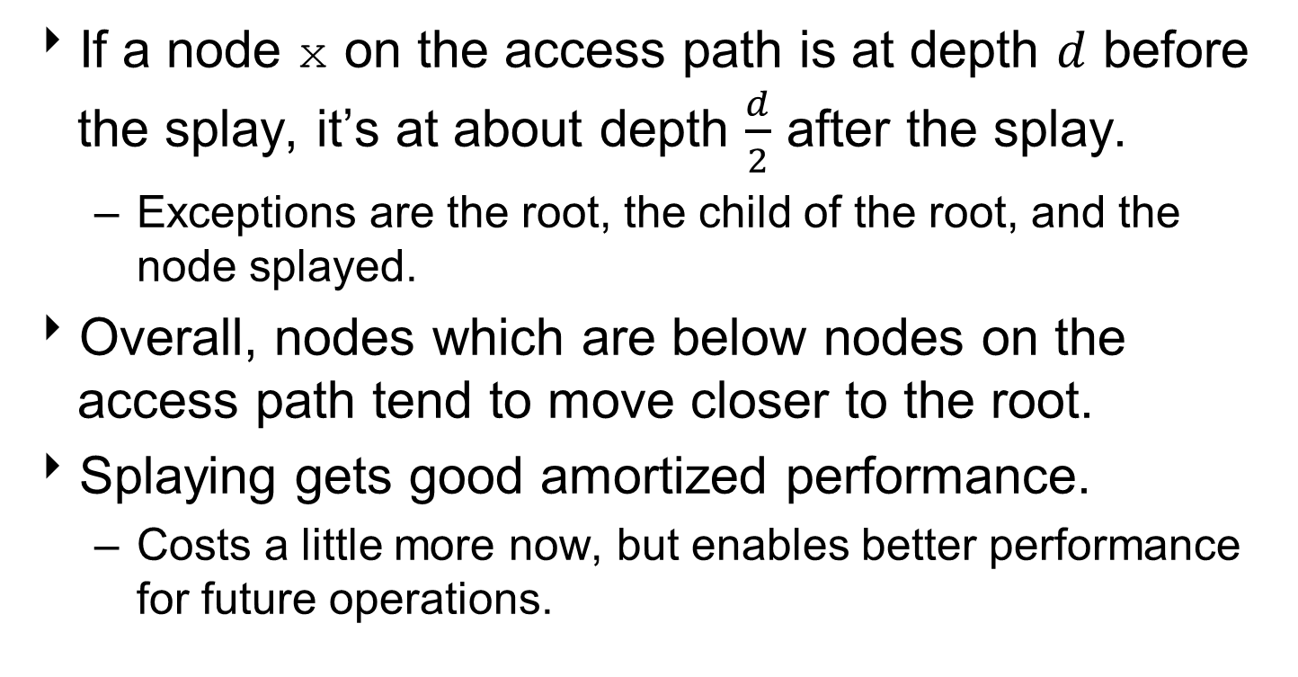
Why Splaying Helps
If a node x on the access path is at depth $d$ before the splay, it’s at about depth $\frac{d}{2}$ after the splay.
Exceptions are the root, the child of the root, and the node splayed.
Overall, nodes which are below nodes on the access path tend to move closer to the root.
Splaying gets good amortized performance.
Costs a little more now, but enables better performance for future operations.

Slide 77
Analysis of Splay Trees
Splay trees tend to be balanced.
m operations takes time O(m log n) for m > n operations on n items. (Proof is difficult.)
Amortized O(log n) time.
However, in the worst case, all nodes on one side of tree.
Operations take O(n).
Splay trees have good “locality” properties:
Recently accessed items are near the root of the tree.
Items near an accessed item are pulled toward the root.

Slide 78
Measuring Tree Balance
In a tree, the balance factor of a node x is defined as the difference in the heights of its two sub-trees:
$$BalanceFactor\left(x\right)=Height\left(Right\left(x\right)\right)−Height(Left\left(x\right))$$
Node height is the number of edges between a node and the furthest leaf in its sub-trees.
Nodes with balance factors $<0$ are called "left-heavy."
Nodes with balance factors $>0$ are called "right-heavy."
Nodes with balance factors $=0$ are called "balanced."
A balanced tree is a tree in which all of its nodes are balanced.

Slide 79
Calculating Balance Factor
For instance, the balance factor of J is:
$$BalanceFactor\left(J\right)=Height\left(Right\left(J\right)\right)−Height\left(Left\left(J\right)\right)$$
$$BalanceFactor\left(J\right)=Height\left(P\right)−Height\left(F\right)$$
$$BalanceFactor\left(J\right)=3−2$$
$$BalanceFactor\left(J\right)=+1$$
h = 2
h = 3

Slide 80
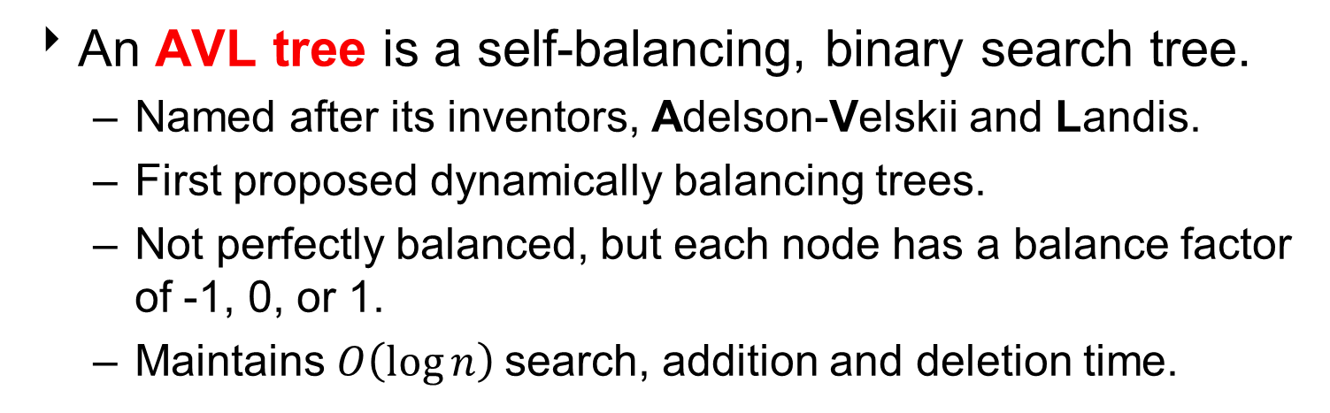
AVL-Trees
An AVL tree is a self-balancing, binary search tree.
Named after its inventors, Adelson-Velskii and Landis.
First proposed dynamically balancing trees.
Not perfectly balanced, but each node has a balance factor of -1, 0, or 1.
Maintains $O\left(\log{n}\right)$search, addition and deletion time.

Slide 81
Unbalanced AVL-Trees
Insertions and deletions may change the balance factor of nodes in a binary search tree.
For instance, given this deletion:
-1
-2
6
6
0
0
Delete 8
0
3
8
3
0
0
0
0
2
5
2
5

Slide 82
Unbalanced AVL-Trees
or this insertion:
-1
-2
6
6
0
0
Insert 4
+1
0
3
8
3
8
0
0
0
+1
2
5
2
5
0
4

Slide 83
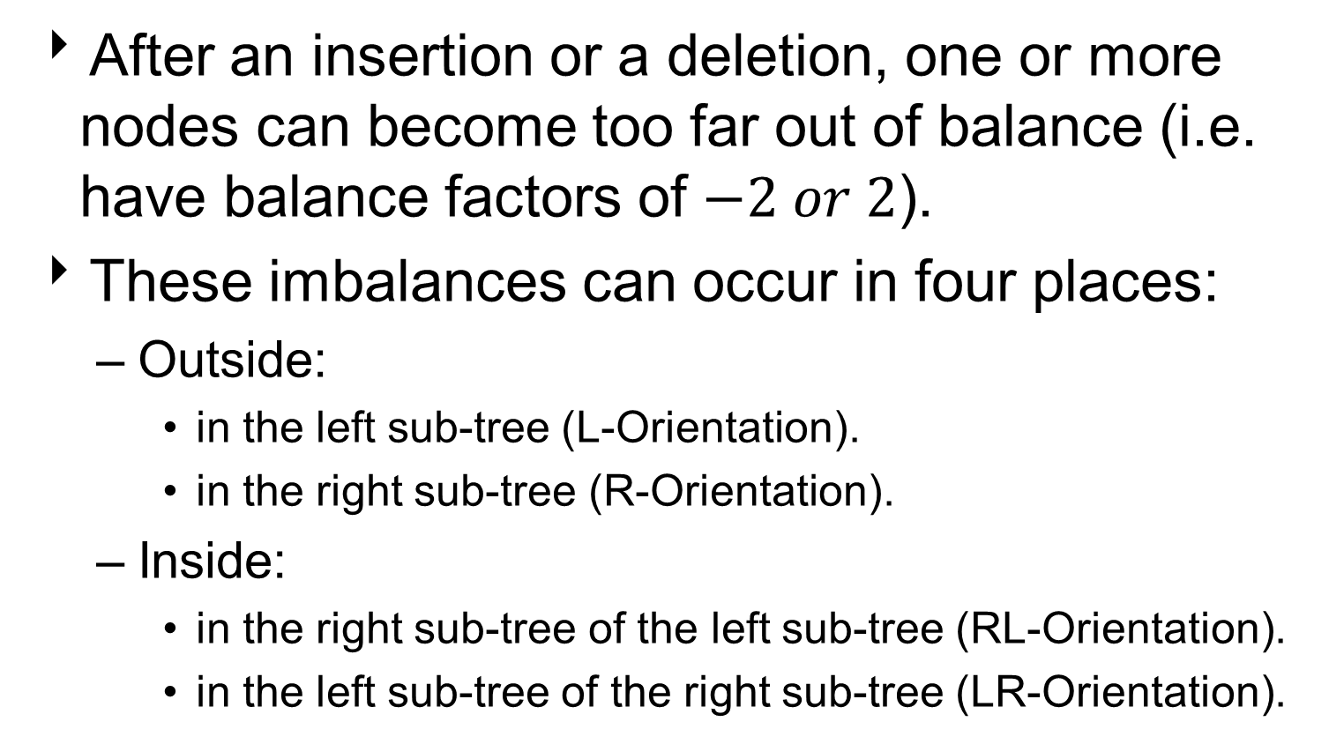
AVL-Tree Imbalance
After an insertion or a deletion, one or more nodes can become too far out of balance (i.e. have balance factors of $−2 or 2$).
These imbalances can occur in four places:
Outside:
in the left sub-tree (L-Orientation).
in the right sub-tree (R-Orientation).
Inside:
in the right sub-tree of the left sub-tree (RL-Orientation).
in the left sub-tree of the right sub-tree (LR-Orientation).

Slide 84
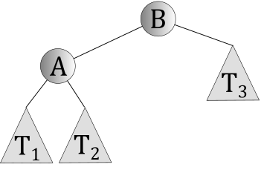
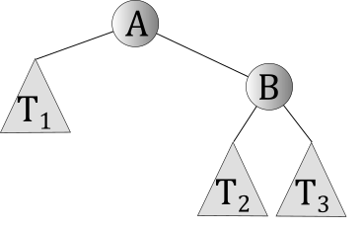
AVL-Tree Imbalances
Outside:
L-Orientation:
Left sub-tree
R-Orientation:
Right sub-tree
Note: T₁, T₂, and T₃ represent arbitrary subtrees, which may be empty or may contain any number of nodes.

Slide 85
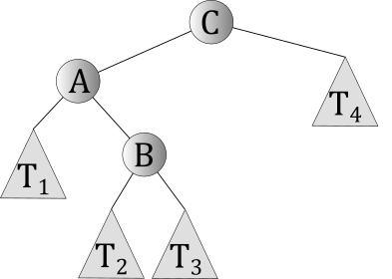
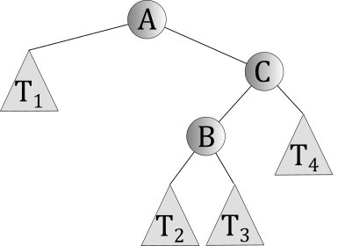
AVL-Tree Imbalances
Inside:
LR-Orientation:
Right sub-tree of left sub-tree
RL-Orientation:
Left sub-tree of right sub-tree

Slide 86
AVL-Tree Rotation
To rebalance an AVL-Tree, perform one or more tree rotations.
There are 4 types of tree rotations, depending on where the imbalance occurs in the tree:
Outside:
L-Rotation – for R-Orientation.
R-Rotation – for L-Orientation.
Inside:
LR-Rotation – LR-Orientation.
a L-Rotation followed by a R-Rotation.
RL-Rotation – RL-Orientation.
a R-Rotation followed by a L-Rotation.

Slide 87
Key Idea
If a node is out of balance in a given direction, rotate it in the opposite direction.
rotation: A swap between a parent and its left or right child, maintaining proper BST ordering.
25
8
rotate right
8
3
25
3
11
11

Slide 88
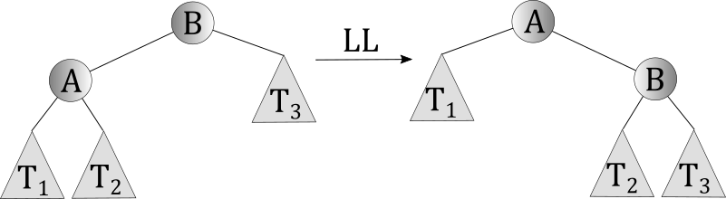

R-Rotations
When insert a node into the left sub-tree of a left sub-tree, it may cause a sub-tree imbalance.
To rebalance, perform a R-Rotation in the clockwise direction.
$$R$$

Slide 89
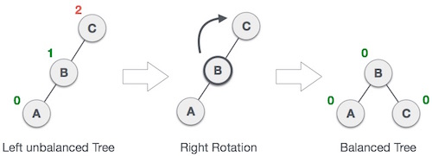
Example: R-Rotation
Below, when A is inserted into the left sub-tree of C’s left sub-tree, C has a -2 imbalance.
We perform a R-Rotation by making C the right-subtree of its left sub-tree, B.
Note: If B had a right sub-tree, that sub-tree would become C’s left sub-tree (i.e. a second right rotation).
-2
-1
0

Slide 90
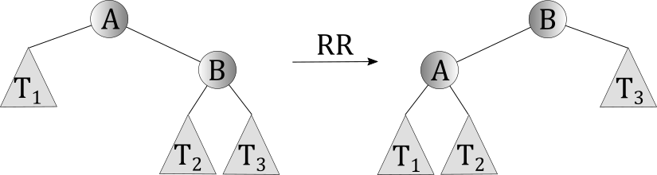

L-Rotations
When insert a node into the right sub-tree of a right sub-tree, it may cause a sub-tree imbalance.
To rebalance the tree, perform a L-Rotation, in the counter-clockwise direction.
$$L$$

Slide 91
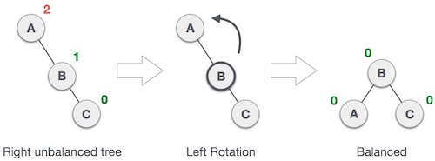
Example: L-Rotation
Below, when C is inserted into the right sub-tree of A’s right sub-tree, A has a +2 imbalance.
Perform a left rotation by making A the left-subtree of its right sub-tree, B.
Note: If B had a left sub-tree, that sub-tree would become A’s right sub-tree (i.e. a second left rotation).
+2
+1
0

Slide 92
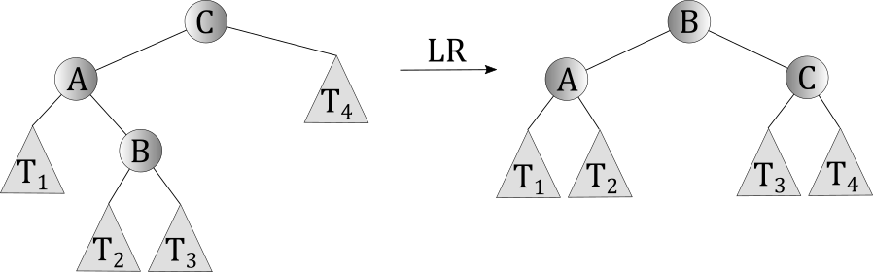

LR-Rotations
When insert a node into the right sub-tree of a left sub-tree, it may cause a sub-tree imbalance.
To rebalance, perform a LR-Rotation.
Inside rotations are combinations of the outside rotations.
A LR-Rotation is the combination of a L-Rotation and a R-Rotation.
$$LR$$

Slide 93

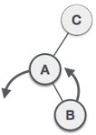
Example: LR-Rotation
-2
For example, when B is inserted into the right sub-tree of C’s left sub-tree, C has a -2 imbalance.
+1
Perform a L-Rotation on the left sub-tree of C. This makes A the left sub-tree of B.
Note: If B had a left sub-tree, it would become A’s right sub-tree.

Slide 94
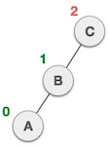
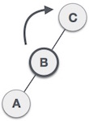
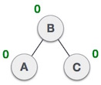
Example: LR-Rotation
-2
The sub-tree is still unbalanced. However, it’s now because of the left sub-tree of the left sub-tree.
-1
0
Perform a R-Rotation, making B the new root node of this sub-tree. C becomes the right sub-tree of its left sub-tree, B.
Note: If B had a right sub-tree, it would become C’s left sub-tree.
The sub-tree is now balanced.

Slide 95
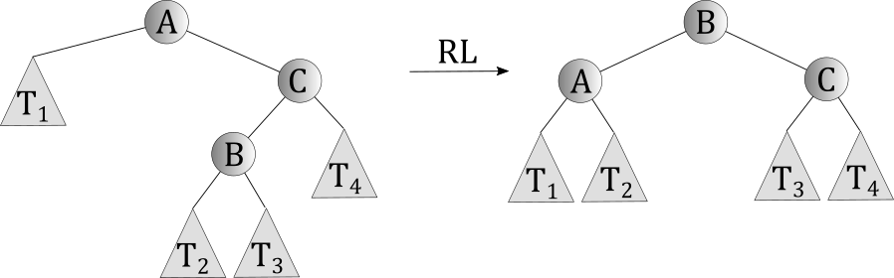

RL-Rotations
When insert a node into the left sub-tree of a right sub-tree, it may cause a sub-tree imbalance.
To rebalance, perform a RL-Rotation.
A RL-Rotation is the combination of a R-Rotation a L-Rotation.
$$RL$$

Slide 96

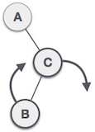
Example: RL-Rotation
+2
For example, when B is inserted into the left sub-tree of A’s right sub-tree, B has a +2 imbalance.
-1
Perform a R-Rotation on the right sub-tree of A. This makes C the right sub-tree of B.
Note: If B had a right sub-tree, it would become C’s left sub-tree.

Slide 97
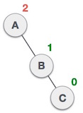
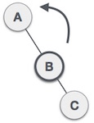
Example: RL-Rotation
+2
The sub-tree is still unbalanced. However, it’s now because of the right sub-tree of the right sub-tree.
-1
0
Perform L-Rotation, making B the new root of the sub-tree. A becomes the left sub-tree of its right sub-tree B.
Note: If B had a left sub-tree, it would become A’s right sub-tree.
The sub-tree is now balanced.

Slide 98
AVL-Tree Insertion
Insert the new node into the tree, like insertion into a binary search tree.
Fix tree balance via rotations, if necessary.
A rotation is performed in sub-trees with a root that has a balance factor equal to +2 or -2.
If there is more than one imbalance, first rotate at the node closest to the newly inserted node.

Slide 99
Example: Insertion I
Insert 15 in the following AVL-Tree:
-1
10
0
-1
5
20
-1
+1
0
4
7
12
0
0
2
8

Slide 100
Example: Insertion I
Insertion induces left, right imbalance
-1
10
0
-2
5
20
-1
+1
0
4
7
12
0
0
2
8
15

Slide 101
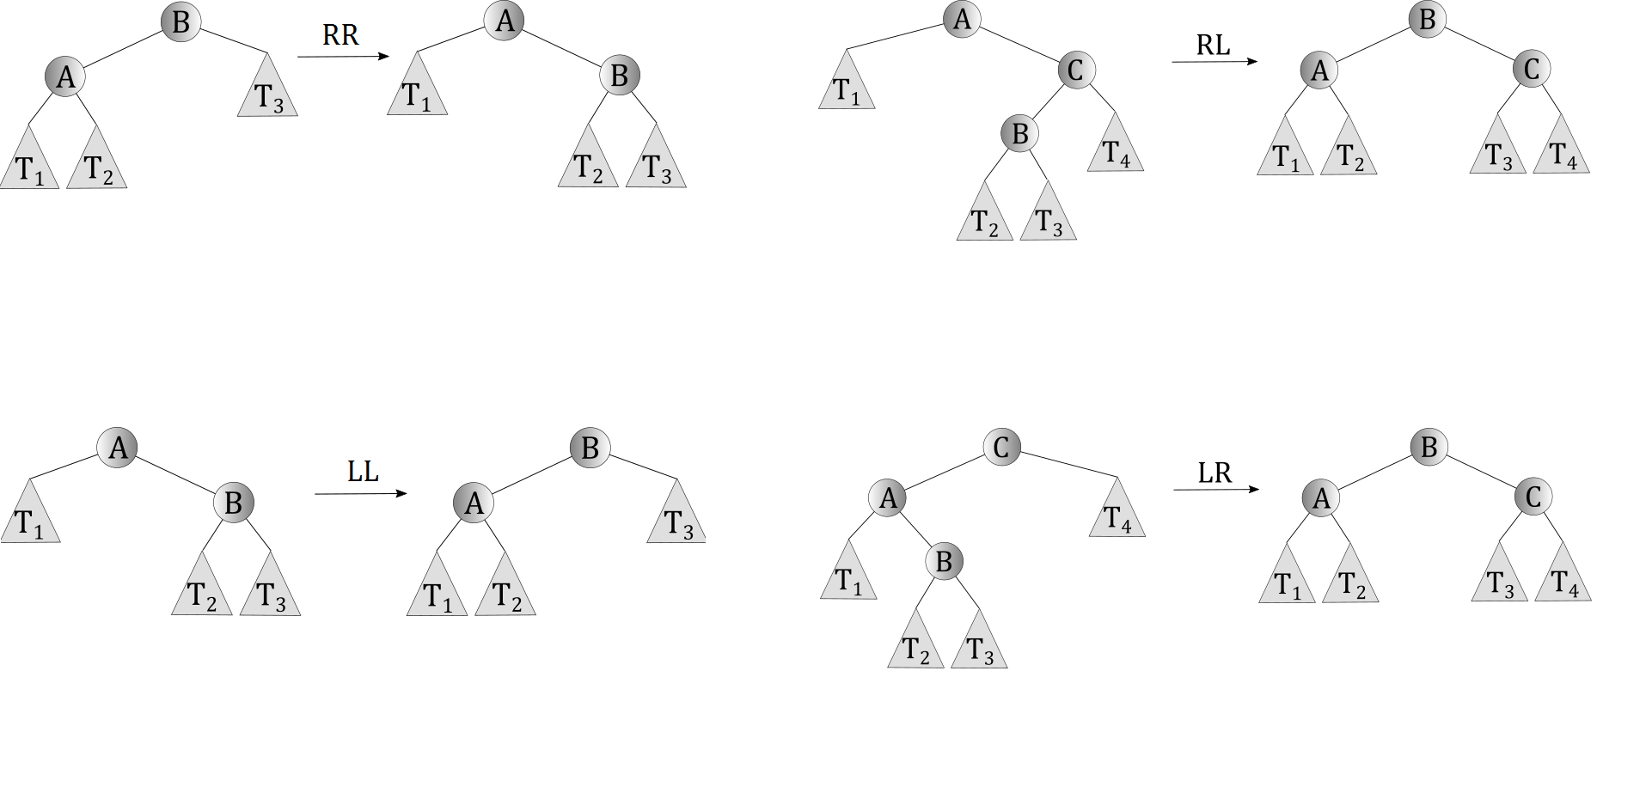
Example: Insertion I
Which rotation use?

Slide 102
Example: Insertion I
After apply LR-Rotation at node 20
-1
10
0
0
5
15
-1
+1
0
0
4
7
12
20
0
0
2
8

Slide 103
Example: Insertion II
Insert 9 in the following AVL-Tree:
-1
10
0
-1
5
20
-1
+1
0
4
7
12
0
0
2
8

Slide 104
Example: Insertion II
Insertion induces left, right imbalance
-2
10
+1
-1
5
20
-1
+2
0
4
7
12
We rotate at 7, closest node to 9
0
+1
2
8
and a right, right imbalance.
9

Slide 105
Example: Insertion II
Which rotation use?

Slide 106
Example: Insertion II
Note: Removes imbalance at node 10
-1
10
0
-1
5
20
-1
0
0
4
8
12
0
0
0
2
7
9
After apply LL-Rotation at node 7

Slide 107
AVL-Trees Deletion
Delete node as in other binary search trees
Fix tree balance via rotations, if necessary.
A rotation is performed in sub-trees having a root that has a balance factor equal to +2 or -2.
If there is more than one imbalance, first rotate at the node closest to the deleted node.

Slide 108
Example: Deletion I
Delete 7 from the following AVL-Tree:
-1
10
0
-1
5
20
-1
+1
0
4
7
12
0
0
2
8

Slide 109
Example: Deletion I
-1
10
-1
-1
No need to rotate!
5
20
-1
0
0
4
8
12
0
2
After deleting 7

Slide 110
Example: Deletion II
Delete 10 from the following AVL-Tree:
-1
10
0
-1
5
20
-1
+1
0
4
7
12
0
0
2
8

Slide 111
Example: Deletion II
After deleting 10, promote its successor, 12
-2
12
0
0
5
20
-1
+1
4
7
0
0
2
8
Could also promote its predecessor, 8

Slide 112
Example: Deletion II
Deletion induces left, left imbalance
Choose to use RR-Rotation but could use a LR-Rotation too.
-2
12
0
0
5
20
-1
+1
4
7
and a left, right imbalance!
0
0
2
8

Slide 113
Example: Deletion II
Which rotation use?

Slide 114
Example: Deletion II
After apply RR-Rotation at node 12
+1
5
-1
-1
4
12
0
+1
0
2
7
20
0
8

Slide 115
Example: Deletion III
Delete 4 from the following AVL-Tree:
-1
10
+1
-1
5
20
0
-1
0
4
7
12
0
6

Slide 116
Example: Deletion III
Deletion induces right, left imbalance
-1
10
+2
-1
5
20
-1
0
7
12
0
6

Slide 117
Example: Deletion II
Which rotation use?

Slide 118
Example: Deletion III
0
After apply RL-Rotation at node 5
10
0
-1
6
20
0
0
0
5
7
12

Slide 119
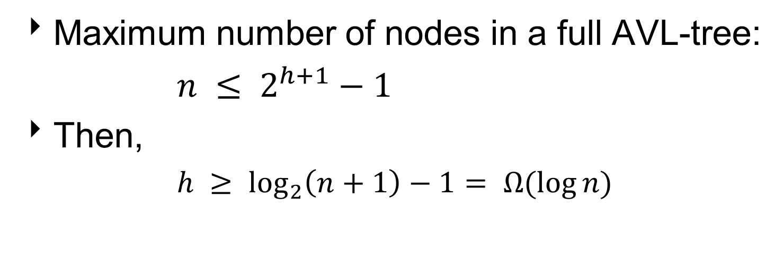
Height of AVL-Trees
Maximum number of nodes in a full AVL-tree:
$n ≤ 2^{h+1}−1$
Then,
$h ≥ \log_{2}\left(n+1\right)−1= Ω(\log{n})$

Slide 120
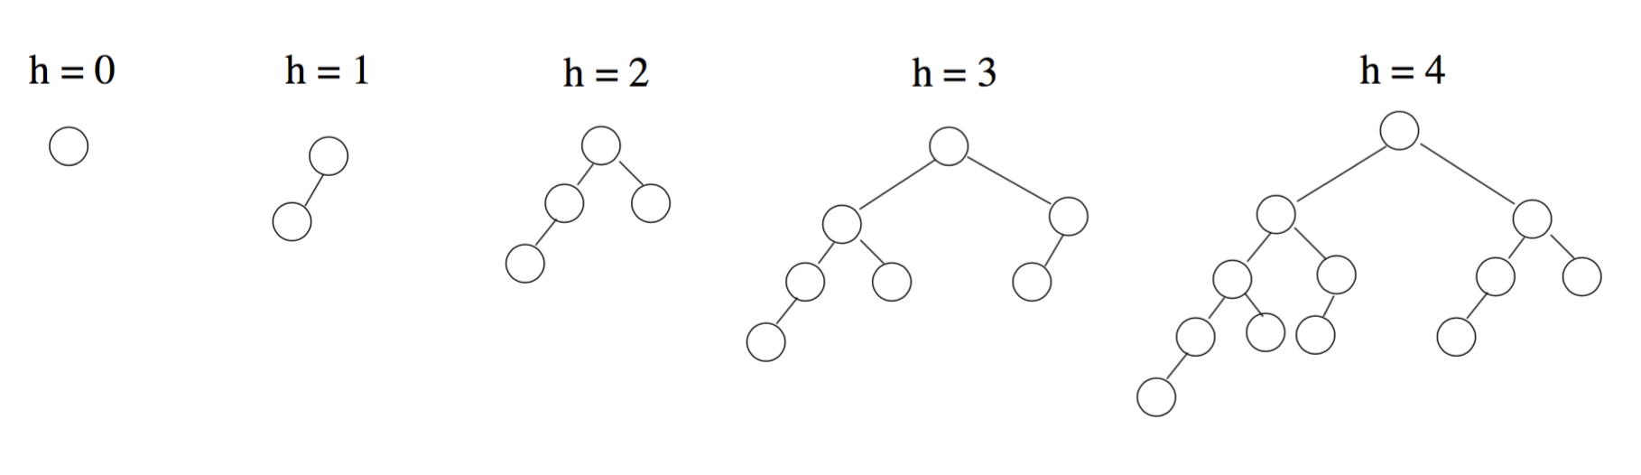
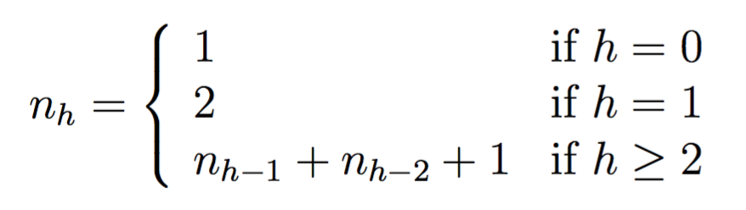
Minimum Number of Nodes
Minimum number of nodes in the AVL-tree:
n_{h}: minimum number of nodes when the height is h

Slide 121
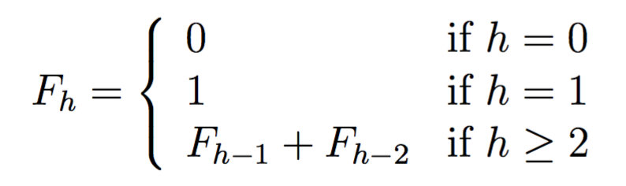
Minimum Number of Nodes
Minimum number of nodes in the AVL-tree:
Recall the Fibonacci numbers
n_{h} = F_{h} + 1

Slide 122

Height of AVL-Trees
Minimum number of nodes in the AVL-tree:
$n_{h}=F_{h}+1⟹n_{h}>F_{h}$
$F_{h}$ is the closest integer to $\frac{φ^{h}}{\sqrt{5}}$, where $φ=1.618$
Then, $F_{h}≈\frac{φ^{h}}{\sqrt{5}}$
and $n_{h}>\frac{φ^{h}}{\sqrt{5}}$,
then $h< \log_{φ}{\sqrt{5}}+\log_{φ}{n}=O(\log{n})$
Since h is $Ω(\log{n})$and $O\left(\log{n}\right),$h is $Θ(\log{n})$.

Slide 123

Disadvantages of AVL-Trees
Difficult to program and debug.
Asymptotically faster than other self-adjusting trees but rebalancing takes time.
Most large searches are done in database systems on disk and use other structures (e.g. B-trees).
A $O(n)$ runtime for a single operation may be justified, if total run time for many consecutive operations is fast (e.g. Splay trees).

Slide 124

Advantages of AVL-Trees
Since AVL-Trees are always close to balanced, search is $O(\log{n})$.
Insertion and deletion are also $O(\log{n})$.
For both insertion and deletion, height re-balancing adds no more than a constant factor to the runtime.

Slide 126
Balanced Trees Abs(depth(leftChild) – depth(rightChild)) <= 1 Depth of a tree is it’s longest path length
Red-black trees – Restructure the tree when rules among nodes of the tree are violated as we follow the path from root to the insertion point.
AVL Trees – Maintain a three way flag at each node (-1,0,1) determining whether the left sub-tree is longer, shorter or the same length. Restructure the tree when the flag would go to –2 or +2.
Splay Trees – Don’t require complete balance. However, N inserts and deletes can be done in NlgN time. Rotates are done to move accessed nodes to the top of the tree.

Slide 127
Conclusion
A balanced binary search tree.
Doesn’t need any extra information to be stored in the node, ie color, level, etc.
Balanced in an amortized sense.
Running time is O(mlog n) for m operations
Can be adapted to the ways in which items are being accessed in a dictionary to achieve faster running times for the frequently accessed items.(O(1), AVL is about O(log n), etc.)

Slide 128
Which algorithm is best?
Advantages
AVL: relatively easy to program. Insert requires only one rotation.
Splay: No extra storage, high frequency nodes near the top
RedBlack: Fastest in practice, no traversal back up the tree on insert
Disadvantages
AVL: Repeated rotations are needed on deletion, must traverse back up the tree.
SPLAY: Can occasionally have O(N) finds, multiple rotates on every search
RedBlack: Multiple rotates on insertion, delete algorithm difficult to understand and program

Slide 129
AVL Insertion: Outside Case
j
Consider a valid
AVL subtree
k
h
Z
h
h
X
Y

Slide 130
AVL Insertion: Outside Case
j
Inserting into X
destroys the AVL
property at node j
k
h
Z
h+1
h
Y
X

Slide 131
AVL Insertion: Outside Case
j
Do a “right rotation”
k
h
Z
h+1
h
Y
X

Slide 132
Single right rotation
j
Do a “right rotation”
k
h
Z
h+1
h
Y
X

Slide 133
Outside Case Completed
k
“Right rotation” done!
(“Left rotation” is mirror
symmetric)
j
h+1
h
h
X
Y
Z
AVL property has been restored!

Slide 134
AVL Insertion: Inside Case
j
Consider a valid
AVL subtree
k
h
Z
h
h
X
Y

Slide 135
AVL Insertion: Inside Case
Inserting into Y
destroys the
AVL property
at node j
j
Does “right rotation”
restore balance?
k
h
Z
h
h+1
X
Y

Slide 136
AVL Insertion: Inside Case
k
“Right rotation”
does not restore
balance… now k is
out of balance
j
h
X
h
h+1
Z
Y

Slide 137
AVL Insertion: Inside Case
Consider the structure
of subtree Y…
j
k
h
Z
h
h+1
X
Y

Slide 138
AVL Insertion: Inside Case
j
Y = node i and
subtrees V and W
k
h
Z
i
h
h+1
X
h or h-1
V
W

Slide 139
AVL Insertion: Inside Case
j
We will do a left-right
“double rotation” . . .
k
Z
i
X
V
W

Slide 140
Double rotation : first rotation
j
left rotation complete
i
Z
k
W
V
X

Slide 141
Double rotation : second rotation
j
Now do a right rotation
i
Z
k
W
V
X

Slide 142
Double rotation : second rotation
right rotation complete
Balance has been
restored
i
k
j
h
h
h or h-1
V
X
W
Z

Slide 143
Implementation
balance (1,0,-1)
key
left
right
No need to keep the height; just the difference in height, i.e. the balance factor; this has to be modified on the path of insertion even if you don’t perform rotations
Once you have performed a rotation (single or double) you won’t need to go back up the tree

